Slide 1

Housing Project

Slide 2
INTRODUCTION
Houses are one of the necessary need of each and every person around the globe and therefore housing and real estate market is one of the markets which is one of the major contributors in the world’s economy. It is a very large market and there are various companies working in the domain. Data science comes as a very important tool to solve problems in the domain to help the companies increase their overall revenue, profits, improving their marketing strategies and focusing on changing trends in house sales and purchases. Predictive modelling, Market mix modelling, recommendation systems are some of the machine learning techniques used for achieving the business goals for housing companies. Our problem is related to one such housing company.

Slide 3
Hardware and Software Requirements and Tools Used
RAM: 8GB
ROM: I3 processor
SOFTWARE: Python 3.9.6
LIBRARIES: Numpy, Pandas, Seaborn, Sklearn, Scipy .
Tools: Jupiter notebook, Matplotlib, Scikit-learn, Excel.
Testing of Identified Approaches (Algorithms)
K-Neighbors Regressor
Decision Tree Regressor
Random Forest Regressor
Ridge
Lasso

Slide 4
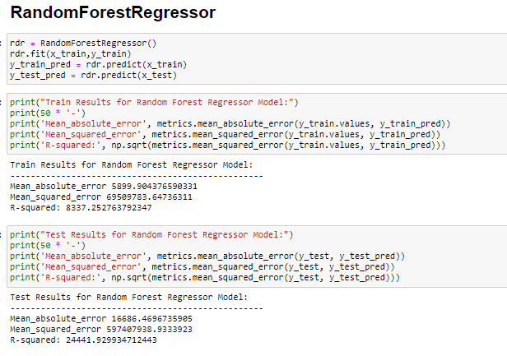
Run and Evaluate selected models
MODELS

Slide 5
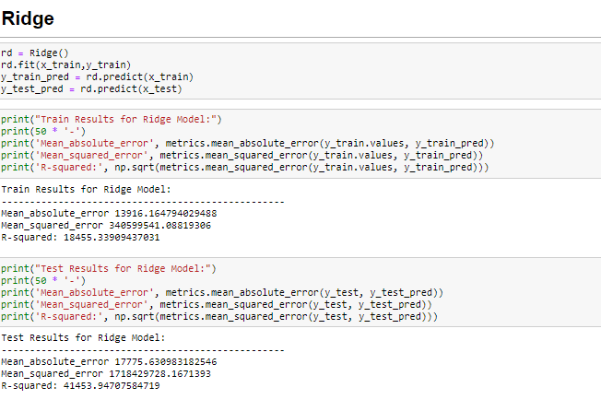

Slide 6
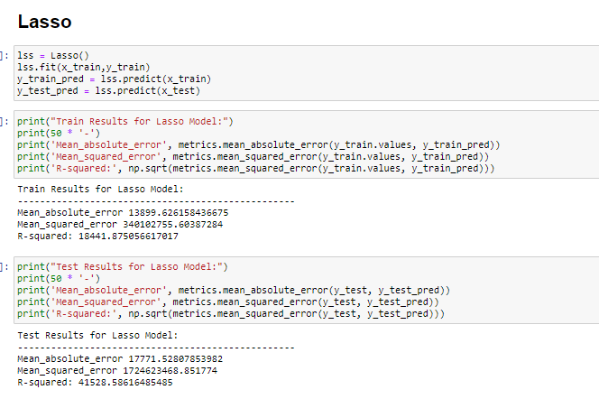

Slide 7
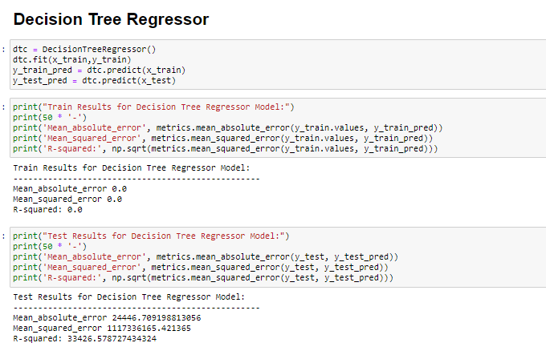

Slide 8
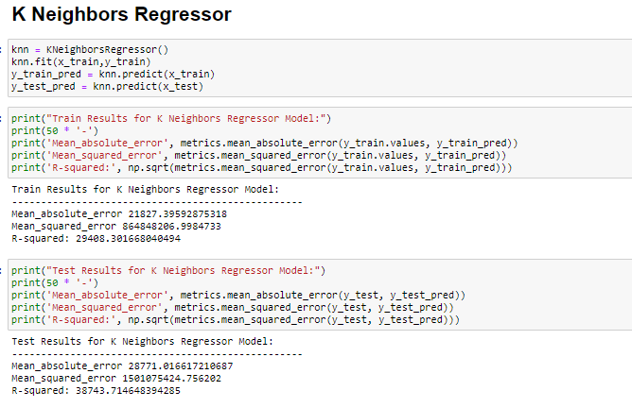

Slide 9
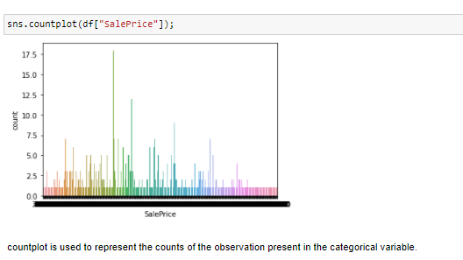
Visualizations
Count plot
Boxplot
Distplot
Scatterplot
Heatmap
Count plot

Slide 10
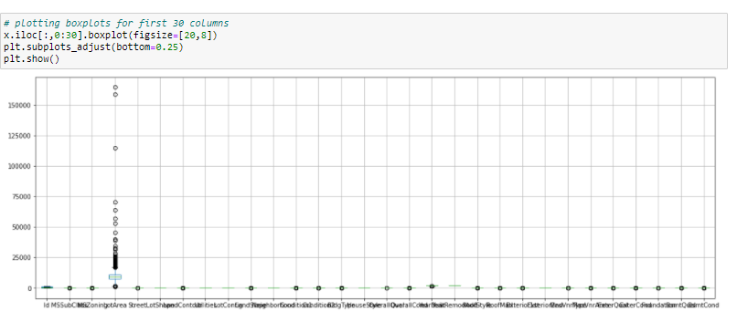
Boxplot

Slide 11
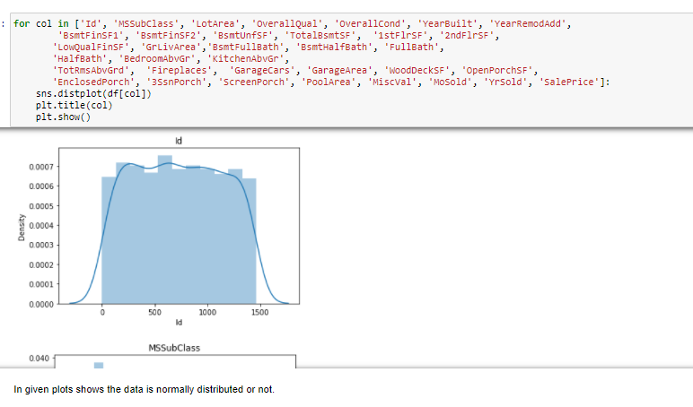
Distplot

Slide 12
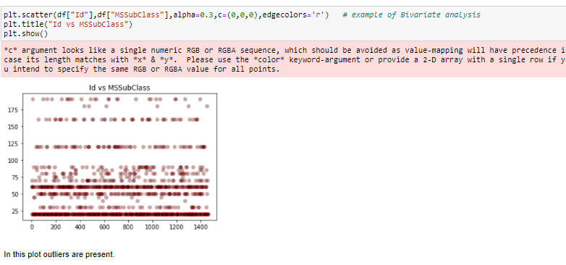
Scatterplot

Slide 13
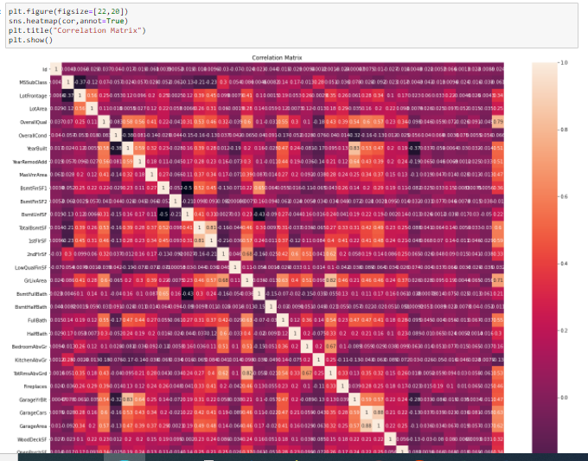
Heatmap

Slide 14
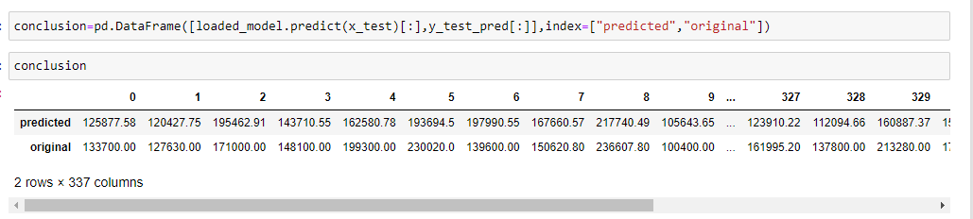
CONCLUSION
In these project, Decision Tree Regressor, Random Forest Regressor, K-Neighbors Regressor, Ridge, Lasso these models are used.
Random Forest Regressor is r2 score ,Mean absolute error ,Mean_squared_error and R-squared is good than other models, Hence Random Forest Regressor is performing is good.
Random Forest Regressor is best model for this dataset.

Slide 15
THANK YOU

